Slide 1
RASP® Reduced Agricultural Spoilage Program A Food Loss and Waste Solution
Developed by
RASP, LLC
A Wholly Owned Subsidiary of
Nenko Advisors International, LLC

Slide 2
Introduction to RASP®
In today’s world of growing populations, we are revisiting the old adage and applying it to agriculture:
"Give a man a fish and he eats for a day; teach a man to fish and he eats for a lifetime."
However, we are letting these newly-educated men and women down by not providing them with the infrastructure needed to save, sell, or transport what they grow.

Slide 3
Global Food Loss Problem
1.3 billion tons of food Is wasted each year.
1.2 billion people go to bed hungry every night.
$1 trillion total in global food waste and loss.
2/3 OF THE FOOD WASTE IS DUE TO POST-HARVEST LOSS
Loss occurs at the front of the food chain—when food rots in fields, or is lost as a result of poor transportation networks, or spoils in markets that lack proper storage or preservation equipment and practices.
It is expected that the world will need to feed 9 billion people by 2050.

Slide 4
RASP® Solution to Food Loss & Waste
RASP®=Reduced Agricultural Spoilage Program
RASP® is a Totally Self-Contained, Off-The-Grid, Solar-Powered Refrigeration Product
RASP® Can Provide Multiple Functions in a Cold Chain
Scalable to Meet Geographical Needs

Slide 5
Why RASP® ?
RASP® Outperforms the Competition
A robust, low maintenance facility with unique components
Can go anywhere — even where there are no real roads
25-year life on the power generation unit
On-site assembly in three days, by trained installation teams
Remote monitoring to ensure high reliability

Slide 6
What can RASP® Store? Freshly harvested quantities that can be stored in a 1920 cu ft. RASP® unit (Equates to 280 Bushels) Alternatively, the unit has the ability to store twice the quantities below of other food products.
APPLES 5334 KG 11759 LB
POTATOES 7620 KG 16799 LB
CUCUMBERS 6096 KG 13439 LB
CARROTS 6350 KG 13999 LB
EGGPLANTS 4191 KG 9240 LB
ONIONS 7211 KG 15897 LB
PEAS 7620 KG 16799 LB
MANGOES 6958 KG 15340 LB
TOMATOES 6705 KG 14782 LB
PEACHES 6325 KG 13944 LB

Slide 7
What Else Can RASP® Store
RASP® temperature range: -5.6 C to10 C (22 F to 50 F)can store:
Fish
Meat
Dairy
Grains
Vaccines

Slide 8
Components of RASP®
PV (PhotoVoltaic) system designed exclusively for RASP®
State-of-the-art cold room
State-of-the-art battery backup system
Proprietary control and monitoring unit utilizing software integration technology

Slide 9
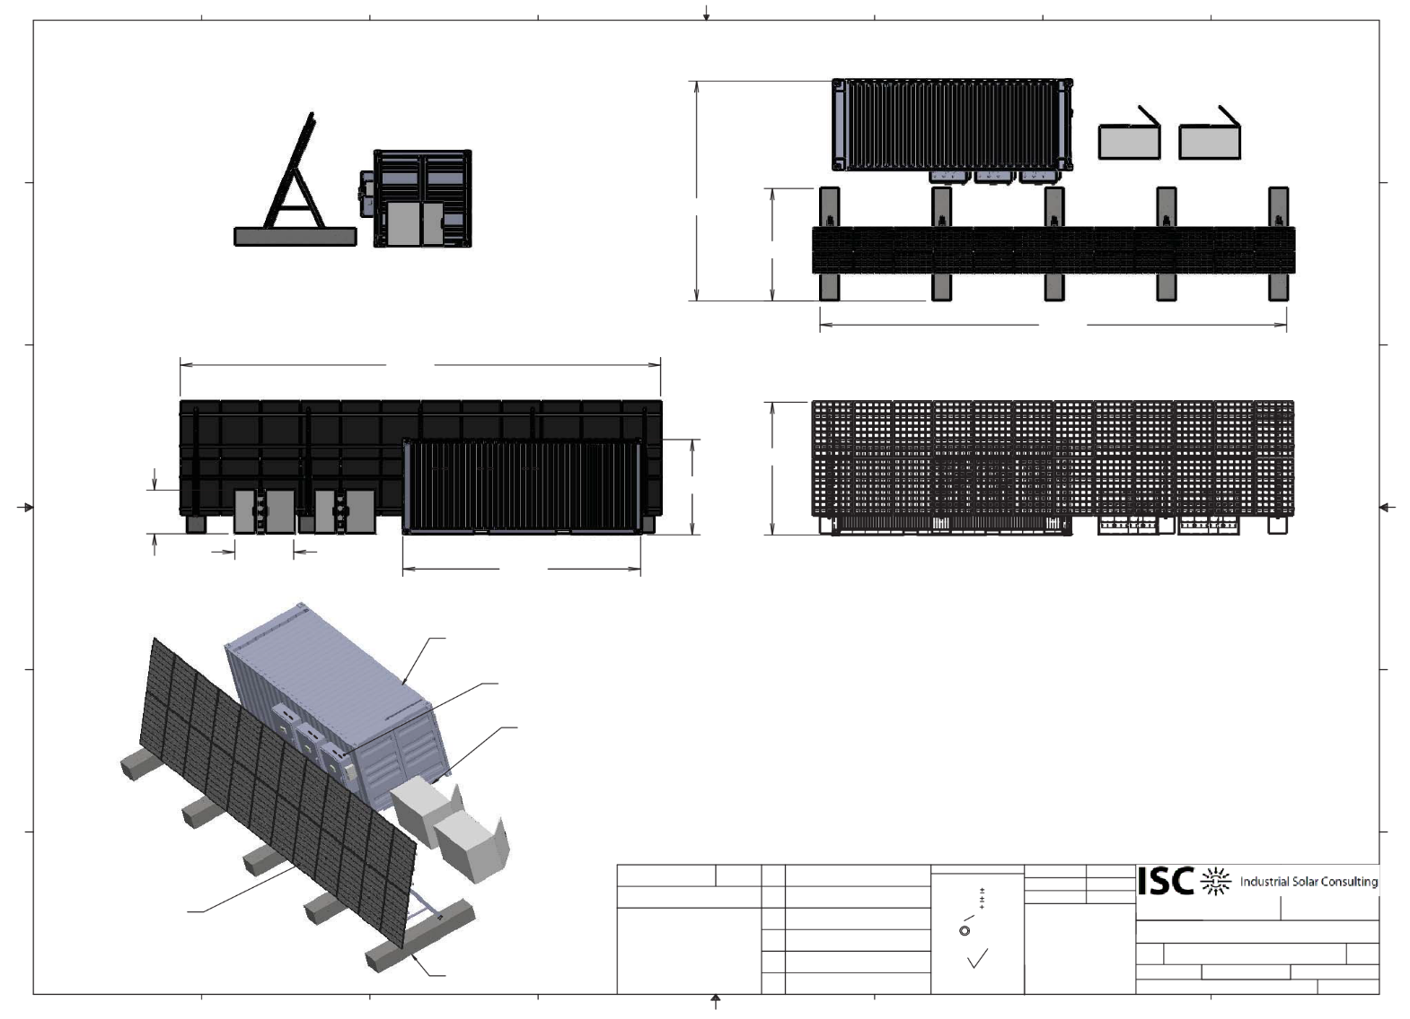
RASP® Layout: Solar Array is 40-feet wide at the base

Slide 10
Sample operational data
Below is data for part of a sixty day test period which shows the Cold Room maintaining a constant temperature of 38 F degrees.
 |  | High |  | Low |  | Humidity% |  |  | Conditions
18-Aug
 | Midnight | 73 |  | 72 |  | 94% |  |  | Partly Cloudy
 | 6am | 79 |  | 72 |  | 92% |  |  | Partly Cloudy
 | Noon | 90 |  | 82 |  | 67% |  |  | Mostly Sunny
 | 6pm | 82 |  | 75 |  | 83% |  |  | Thunderstorms
19-Aug
 | Midnight | 75 |  | 73 |  | 94% |  |  | Clear
 | 6am | 81 |  | 73 |  | 58% |  |  | Sct. Clouds
 | Noon | 88 |  | 75 |  | 72% |  |  | Sct. Clouds
 | 6pm | 75 |  | 73 |  | 99% |  |  | Foggy
20-Aug
 | Midnight | 73 |  | 72 |  | 97% |  |  | Foggy
 | 6am | 81 |  | 72 |  | 91% |  |  | Overcast
 | Noon | 86 |  | 75 |  | 72% |  |  | Mostly Cloudy
 | 6pm | 81 |  | 73 |  | 93% |  |  | Foggy
21-Aug
 | Midnight | 73 |  | 73 |  | 97% |  |  | Foggy
 | 6am | 84 |  | 73 |  | 84% |  |  | Partly Cloudy
 | Noon | 88 |  | 79 |  | 70% |  |  | Mostly Sunny
 | 6pm | 82 |  | 75 |  | 93% |  |  | Partly Cloudy

Slide 11
Management Team
Bruce H. Rubin CPIM, MBA, Co-Founder
30+ years in all phases of supply chain management and operations
25 years of global sourcing experience with travel to India, China, Hong Kong, Taiwan, Malaysia, Korea, Israel, Germany, Belgium and Canada to develop sources, products, relationships and partnerships
Experienced in setting up a national network of 3PL warehouses and systems to support company expansion
Expert in working with major retailers including Wal-Mart, Kmart, Home Depot, Lowes, etc to insure their requirements were met
Experienced in developing and implementing forecasting programs and models to improve customer service and improve inventory turns especially in the area of new products
Developed new products and product lines from concept through final sale
Developed global vendor partnerships and relationships that led to major cost savings and improved quality
Has held various positions in the American Production and Inventory Control Society (APICS) from chapter president to assistant regional vice-president
Holds certification as CPIM in production and inventory management from APICS
Has taught classes for various APICS chapters

Slide 12
Management Team
Jerry “Wolfie” Wolf, Co-Founder
CPA by education and training
30+ years of commercial experience including tenure with two major international accounting firms
Broad range of administrative, supervisory, marketing, sales, public relations and customer service skills
Demonstrated ability to build profitable businesses from inception to thriving operations in real estate and e-commerce
Talented organizer and resourceful problem solver
Ability to perceive trends, adapt to change, make sound business decisions and manage multiple tasks
Experienced in obtaining financing for companies to achieve their growth objectives
History of attracting top talent from multiple sources to build implementation teams that deliver against company objectives
Pioneered high tech security systems with integration into the earliest smart buildings
Pioneer in the field of e-commerce having implemented one of the first successful e-commerce sites on the internet in 1994
Utilizes aggressive, creative strategies for marketing combined with an emphasis on hands-on management
Highly personalized approach to client and customer relations
Articulate communicator and astute motivator capable of influencing and directing others or contributing to collaborative endeavors

Slide 13
RASP® Vendor Teams
Industrial Solar Consulting - ISC specializes in the design, procurement and maintenance of stand-alone, “off-grid” solar and hybrid power systems that require extreme reliability.
Their customer base includes:
BNSF
Motorola
US Army & US Navy
Customs & Border Protection/Dept. of Homeland Security
Federal Aviation Administration
Lowe Refrigeration- A 20+ year old, US-based subsidiary of a leading European producer of cold rooms.

Slide 14
RASP® Vendor Teams (continued)
Radiant Global Logistics - A global leader in logistics and logistical support.
They will handle all the storage, kitting, shipping, and local logistics for the RASP® units, including hiring and coordinating the local labor to be used in the assembly of the units.
ALL OF THE LEAD VENDORS WILL WORK UNDER AND WITH THE RASP® MANAGEMENT TEAM AND BE AN INTEGRAL PART OF OUR EFFORTS, INCLUDING SALES.

Slide 15
RASP® Contact Information
Bruce Rubin
brubin@raspllc.com
Jerry “Wolfie” Wolf
wolfie@raspllc.com

